Slide 1
WELLCOME TO MY PRESENTATION
Presented By
Md. Ashraful Hoque
Junior Instructor (Tech/Mechanical)
Mechanical Technology
Dhaka Polytechnic Institute

Slide 2
Subject : Thermodynamics And Heat Engine
Chapter -13
Topics: Diesel Engine

Slide 3
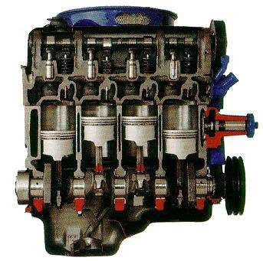
Diesel Engine

Slide 4
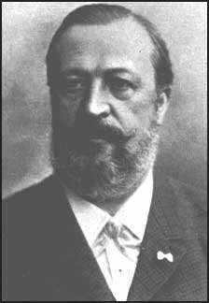
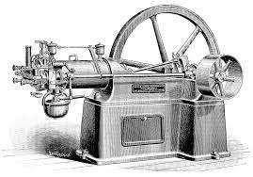
History
The first person to build a working four-stroke engine, a stationary engine using a coal gas-air mixture for fuel (a gas engine), was German engineer Dr. Nikolaus Otto. This is why the four-stroke principle today is commonly known as the Otto cycle and four-stroke engines using spark plugs often are called Otto engines.
Otto Cycle: Dr. Nicolaus Otto -1876

Slide 5
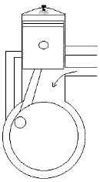
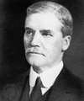
2-Stroke Diesel Engine
Sir Dugald Clerk KBE, FRS (1854, Glasgow –
1932, Ewhurst, Surrey) was a Scottish engineer who designed the world's first successful two-stroke engine in 1878 and patented it in England in 1881.
2-Cycle Engine; Du gal Clerk -1878

Slide 6



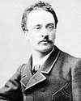
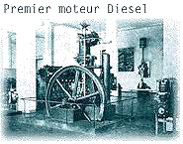
4-Stroke Diesel Engine
Rudolf Christian Karl Diesel (March 18, 1858 – September 29, 1913) was a German inventor and mechanical engineer, famous for the invention of the 4-stroke diesel engine.
Diesel Engine - Dr. Rudolph Diesel -1895

Slide 7
Four Stroke Diesel Engine
Four stroke engine was first demonstrate by Nikolaus Otto in 1876,hence it is also known as Otto cycle. It consist of 4 stroke ,one cycle operation is completed in 4 stroke of the piston, That is one cycle is completed in every 2 revolutions of the crankshaft. Each stroke consist of 180°,of crankshaft rotation and hence a cycle consist of 720°,of crankshaft rotation.

Slide 8
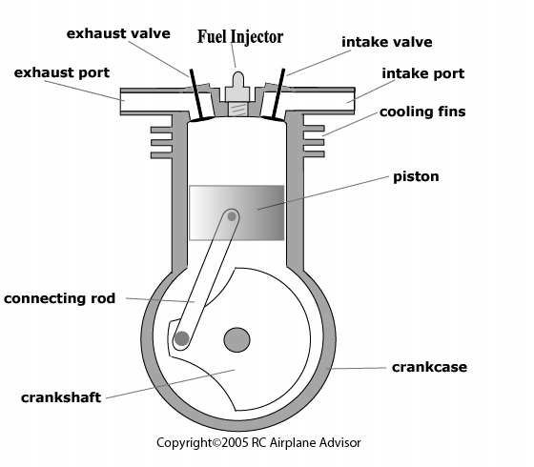
Labelled Diagram of a 4-Stroke Engine

Slide 9
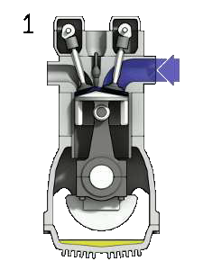
Working of Four Stroke Diesel Engine
Following are the four strokes:-
1 – Intake/Suction stroke 2 – Compression stroke 3 – Expansion stroke
4 – Exhaust stroke

Slide 10
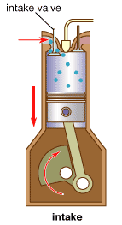
1. Intake Stroke
In suction stroke piston starts at Top Dead Center (TDC) of the cylinder and moves to the Bottom Dead Center (BDC).
Outlet valve will be closed
and inlet valve will be open to allowing the fresh charge of mixed fuel & air into the cylinder.

Slide 11
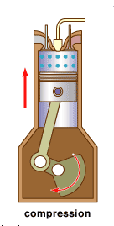
2 . Compression stroke
In compression stroke, Once piston reaches BDC & moves back TDC, inlet valve will be closed. As the piston moves towards TDC. It compress air inside the cylinder & compression takes place. Hence it is called compression stroke.

Slide 12
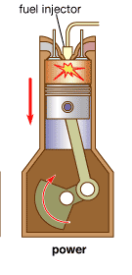
3. Power Stroke
In expansion stroke, Both the valves are closed. When piston reaches top of its stroke. the fuel is sprinkled by the Fuel Injector and the fuel mixture is ignited due to high temperature & pressure generated inside the cylinder
& push down the piston to BDC. Hence it is known as Power or expansion stroke. The Power generated in this stroke is stored in the flywheel for its furthur utilisation in the other strokes.

Slide 13
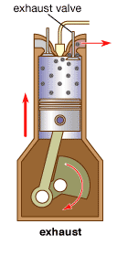
4. Exhaust stroke
In this stroke exhaust valve is opened when piston reaches to BDC & moves to upward.
Piston pushes out the burnt gases to the atmosphere through the exhaust valve. Hence called exhaust stroke & the engine is ready to begin the cycle again.

Slide 14
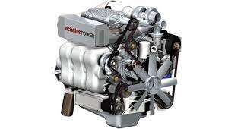
Two stroke engine is first described by Du gal Clerk in 1878.In two stroke engine one cycle is completed in every revolution of crankshaft.
Two Stroke Diesel Engine

Slide 15
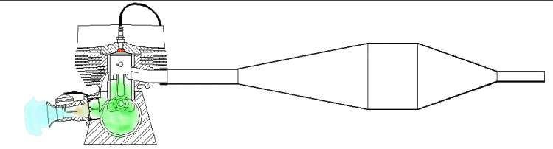
Working of Two Stroke Engine
Two stroke engine is widely used employed where small power required for motor cycle like auto rickshaw, scooter. This type of engine is compact in size , easy for manufacturing and simple in operation. In two stroke engine there are no inlet or exhaust valve as in four stroke engine.

Slide 16
A two-stroke, or two-cycle, engine is a type of internal combustion engine which completes a power cycle in only one crankshaft revolution and with two strokes, or up and down movements, of the piston in comparison to a "four-stroke engine", which uses four strokes. This is accomplished by the end of the combustion stroke and the beginning of the compression stroke happening simultaneously and performing the intake and exhaust (or scavenging) functions at the same time.
Two-stroke engines often provide high power-to-weight ratio, usually in a narrow range of rotational speeds called the "power band". Compared to 4-stroke engines, they have a greatly reduced number of moving parts, are more compact and significantly lighter.

Slide 17
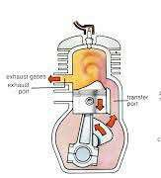
Compression Stroke
When piston moves from BDC to TDC , it first closes the transfer port & then exhaust port. The charge of air-fuel mixture in the chamber is pressurised & creates high temperature.

Slide 18
At the same time a vacuum is developing in the crankcase, so the fresh charge is being drawn into the. As the piston moves towards TDC ,the diesel is added to the pressurised and high tempratured gas which in turn ignites the whole mixture inside the cylinder and forces the piston to move downwards.

Slide 19
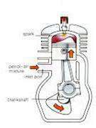
Combustion Stroke
In this stroke both the ports still closed condition , the pressure of the expanding gases forces the piston towards BDC. The pressure in the crankcase is already rising. Later in down stroke exhaust port will be open
& force out the burnt gases.

Slide 20
Very shortly after that the Inlet / Transfer port will also open to intake the fresh charge of fuel mixture and engine is ready to start of the cycle.

Slide 21
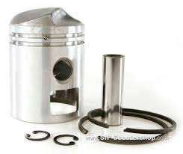
Need of the Piston Crown in a
2-Stroke Engine
Deflector pistons are used in two-stroke engines with crankcase compression, where the gas flow within the cylinder must be carefully directed in order to provide efficient scavenging. With cross scavenging, the transfer (inlet to the cylinder) and exhaust ports are on directly facing sides of the cylinder wall.

Slide 22
To prevent the incoming mixture passing straight across from one port to the other, the piston has a raised rib on its crown. This is intended to deflect the incoming mixture upwards, around the combustion chamber. Much effort, and many different designs of piston crown, went into developing improved scavenging. The crowns developed from a simple rib to a large asymmetric bulge, usually with a steep face on the inlet side and a gentle curve on the exhaust.
Despite this, cross scavenging was never as effective as hoped. This places a pair of transfer ports in the sides of the cylinder and encourages gas flow to rotate around a vertical axis, rather than a horizontal axis.

Slide 23
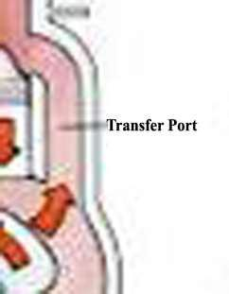
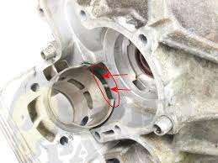
Transfer Port
The Main objective of the transfer port is to supply the fuel from the crank to the cylinder. This is operated under the pressure of the piston.

Slide 24
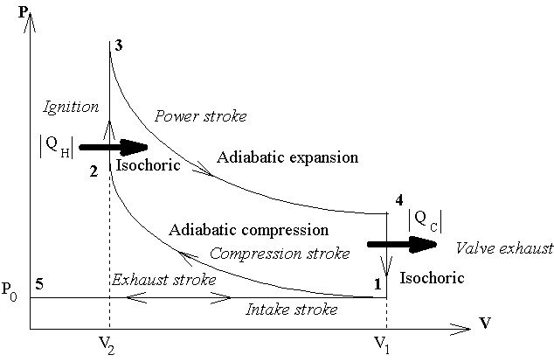
P-V Graph of Diesel Engine
P-V Graph of Diesel Engine

Slide 25
Advantages & Disadvantages of
Two Stroke Engine
Advantages :-
One cycle completed in every revolution of crankshaft.
It is more compact , required less space and lighter in weight than four stroke engine.
The design & construction is much simpler than four stroke engine.
Easy to manufacture & low cost.

Slide 26
There is no suction and exhaust valve used , hence no
need of cam , camshaft and rocker arm etc.
Gives less torsional oscillation.
Requires less spare parts.
Easy for maintenance.

Slide 27
Disadvantages :-
High fuel consumption.
Compression ratio and thermal efficiency is less than that of four stroke engine of the same dimension.
Consumes more lubricating oil.
More wear & tear of moving parts hence it gives loud
noise.

Slide 28
Difference between
4-Stroke Engine & 2-Stroke Engine
4-Stroke Engine
One cycle completed in every 2 revolution of crankshaft
More moving parts
More maintenance
Heavy in weight
More expensive
2-Stroke Engine
One cycle completed in every revolution of crankshaft
Less moving parts
Less maintenance
Light in weight
Less expensive

Slide 29
4-Stroke Engine
Produce more pollution
Long engine life
Not required
Complex design
2-Stroke Engine
Less pollution
Short engine life
Required a mix of oil to lubricate the crankshaft
Simpler design

Slide 30
Fuel Injection System

Slide 31
Introduction
Fuel-Injection System is vital to the working and performance of CI engine. This system serves the purpose of initiating and controlling the combustion to meet the demand requirements.
Fuel is injected into combustion chamber towards the end of compression. It is atomized as it enters under high velocity and the droplets get vaporized to form a fuel-air mixture. Due to continued heat transfer from hot air to fuel, the fuel reaches to its self ignition temperature to ignite spontaneously initiating combustion. Depending upon the demand requirements the fuel injection system continues to deliver the fuel during initial part of combustion.

Slide 32
Classification
Air
Injection
Common rail system
Individual pump and injector system
Distributor system
Injection System
Solid Or Airless Injection

Slide 33
Air Injection System
In this system fuel is injected along wit high pressure air into combustion chamber. The pressure of this air is about 70 bar. A multistage air compressor is required to supply the blast of air at high pressures. A fuel pump draws fuel from fuel tank through a filter and discharge a definite quantity into an injector. The high pressure air from compressor is also led to the injector valve which force the fuel, through the nozzle, when it is opened mechanically.
This type of system is not used now-a-days in diesel engines.

Slide 34
Advantages:-
It provides good atomization and distribution of fuel.
Fuel pump needs to develop less pressure.
Disadvantages:-
It requires high pressure multi stage compressor.
Air compressor needs extra maintenance.

Slide 35
Solid Injection
Or
Airless injection system
In solid Injection system , fuel is directly injected into the cylinder without aid of compressed air. That’s why this system is called solid or airless injection system.
Fuel is supplied at very high pressure (about 200 bar) from fuel pump to fuel injector from where it is injected to the combustion chamber with the help of injector.
There are three types as:
  Common rail system
  Individual pump and injector
  Distributor injection system

Slide 36

Common Rail Injection System
In this system, single fuel pump supplies high pressure diesel oil to common rail or header.
High pressure in the header forces fuel to each of the nozzle. At given instant, the fuel is injected in a specific cylinder by a mechanically operated valve, by means of a push rod and rocker arm.
The amount of fuel is regulated by varying the length of the push rod stroke. The pressure in header is as per injector design for penetration & dispersion of fuel in combustion chamber.

Slide 37
Advantages:-
It can control fuel supply according to load and speed of the
engine.
Only one pump is required for multi cylinder engine.
The arrangement of system is very simple & Maintenance cost is less.
Disadvantages:-
  Very accurate design and workmanship is required.

Slide 38
Individual Pump & Injector
➢In this system , individual
fuel pump is provided for each
nozzle. The metering of fuel quantity and control of injection
timing are done by the each pump for corresponding nozzle.
The needle valve in nozzle is actuated by fuel oil pressure. The amount of fuel entering the cylinders is regulated by changing position of control rack.

Slide 39
Distributor Injection System
In this system, the pump is used to pressurizes, meters and times the injection. Then fuel is supplied to central distributor block. From distributor block fuel is distributed to each cylinder in correct firing order by cam operated poppet valves which open to admit fuel to nozzles.
The
amount of fuel to entering the cylinders is regulated by
changing position of control rack. The number of injection strokes per cycle for the pump is equal to the number of cylinders.

Slide 40
COOLING SYSTEM
A cooling system is the collection of parts and substances that work together to maintain temperature at optimum levels.

Slide 41
WHY COOLING SYSTEM IS NECESSARY IN AN IC
ENGINE?
* Over heating of the parts will result in engine breakdown.
hence it must be cooled properly.
ILL EFFECTS OF OVERHEATING
* Evaporation of lubricating oil.
* Setting up of thermal stress.
* Sticking of piston rings to the grooves.
* Burning of piston crown.
* Burning and warping of exhaust valves.

Slide 42
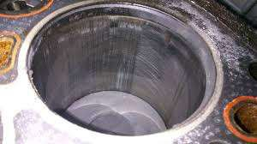
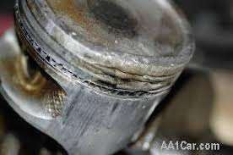
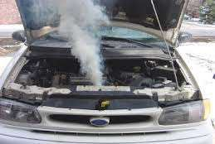

Slide 43
HEAT DISTRIBUTION
* Cylinder
* Cylinder head
* Valves
* Spark plug(petrol\engine)
* Fuel injector (Diesel engines)

Slide 44
OPTIMUM COOLING
* To avoid the overheating as mentioned above, the engine must be cooled in order to run properly but it should not be cooled over.
EFFECTS OF OVERCOOLING
* Reduction in thermal efficiency.
* Increased corrosion in engine parts.
* Improper vaporization of fuel.

Slide 45

TYPES OF COOLING SYSTEMS
The excessive heat carried away by the engine components is to be conveyed finally to the atmosphere by the cooling system.
Two general methods are generally used:
*Air cooled system.
*Liquid cooled system
(a)Thermosyphon (b)Evaporative cooling system
(c)Force circulation cooling system

Slide 46
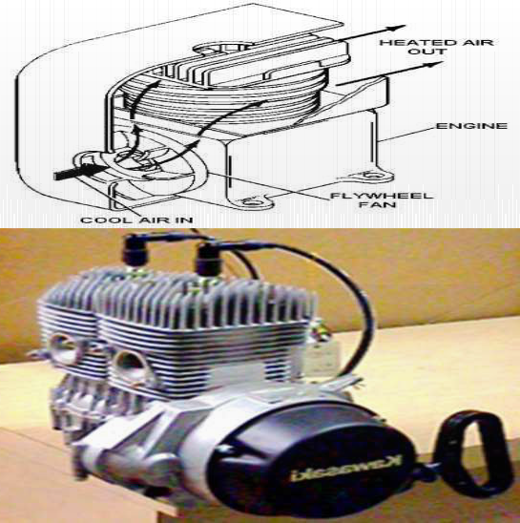
AIR COOLED SYSTEM
*The engine have metal fins on the outer
perimeter of the engine.
*Heat is transferred from fins to atmosphere.
HEAT DISSIPIATING CAPACITY DEPENDS ON THE FOLLOWING:
1.Shape and size of the fins and spacing of the fins.
2.Velocity and amount of the air stream flowing over the fins
3.Temperature of the cylinder , fins and the
cooling air

Slide 47
MERITS AND DEMERITS OF AIR COOLING
MERITS
DEMERITS
1.Engine weight is reduced.
2.Cheaper to manufacture.
3.Overall size is reduced.
4.starting is possible even in frosty weather.
1.Greater mechanical noise.
2.Not suitable for multi-cylinder engine.

Slide 48

LIQUID COOLED SYSTEM
FORCED CIRCULATION COOLING SYSTEM.
THERMOSYPHON.
EVAPORATIVE COOLING.

Slide 49
COMPONENTS OF COOLING SYSTEM
LIQUID COOLED

Slide 50
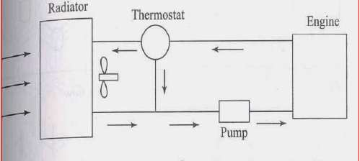
FORCED CIRCULATION COOLING SYSTEM

Slide 51
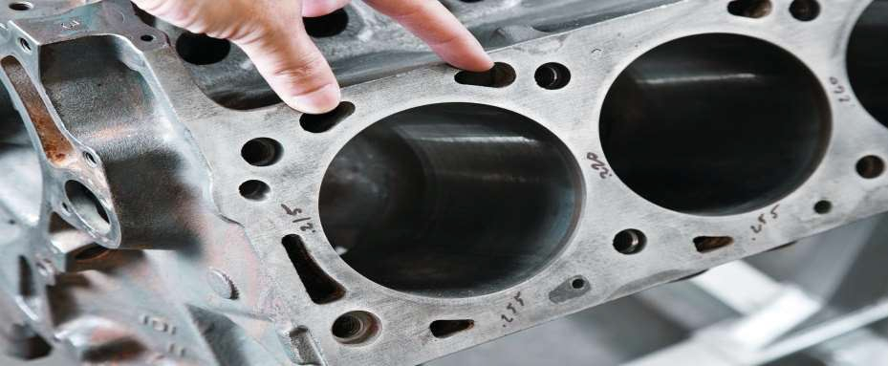
FORCE ASSISTED COOLING SYSTEM
WATER JACKET
In an internal combustion engine the water jacket is a series of holes either cast or bored through the main engine block and connected by inlet and outlet valves to a radiator.

Slide 52
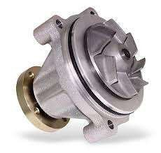
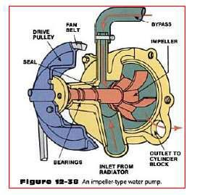
WATER PUMP
*Its purpose is to circulate coolant .
*It is driven by the belt attached to the crank shaft

Slide 53
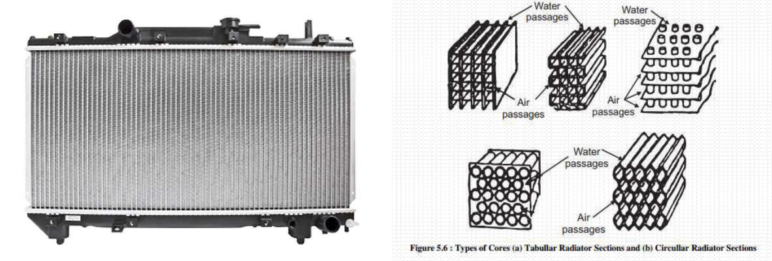
RADIATOR
It is the major part of the cooling system. There is a fluid in the inner core of the radiator and it transfers the heat to the cooling fins that effectively remove heat from the coolant.

Slide 54
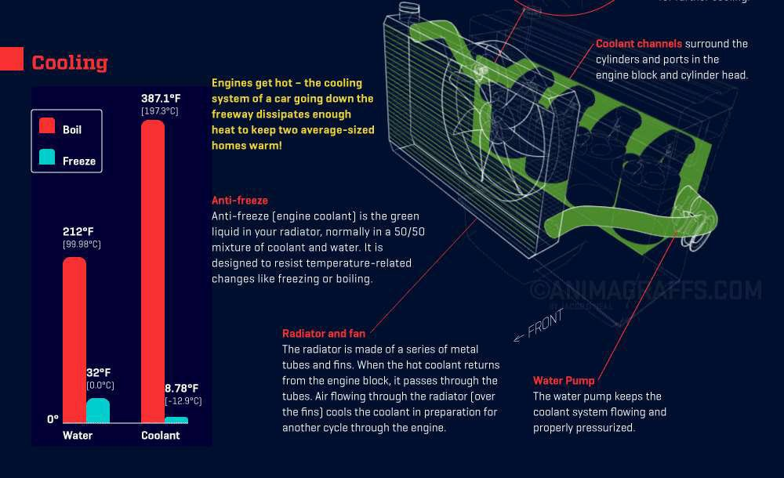
COOLING FANS
Fan blades are made up of sheet metal 1.2 -1.6 mm thickness and are riveted to the hub.
The maximum velocity of the centrifugal fans reaches 70-100m/sec.

Slide 55
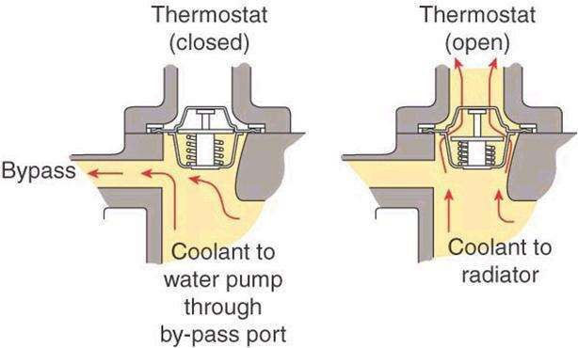
BYPASS
This system helps coolant to pass through the engine and then bypass the radiator and helps the temperature in balancing.
2018

Slide 56
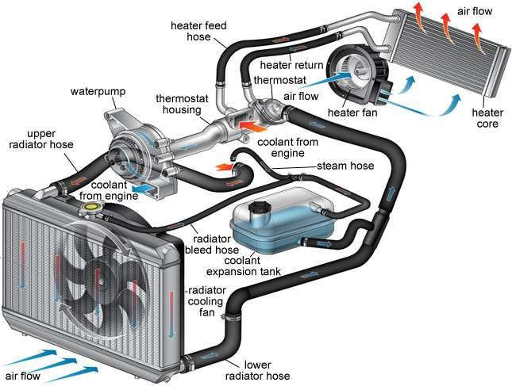
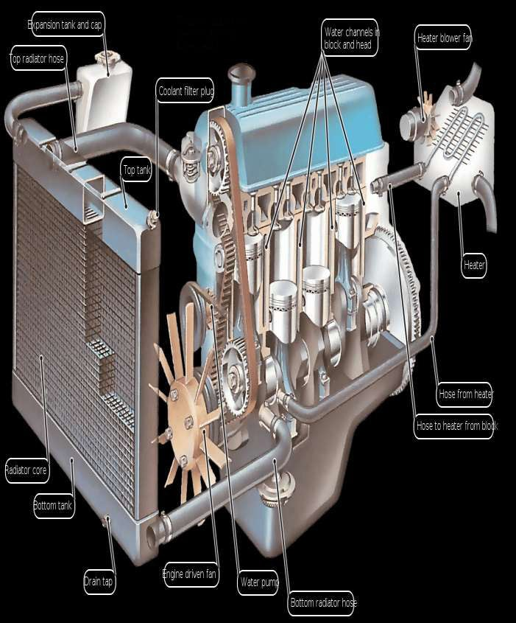

Slide 57
PROBLEMS WITH LIQUID COOLING
Cooling jackets should be free from aeration or bubbles.
Distortion of coolant jacket.
Formation of scales in jacket.

Slide 58
Any Questions?

Slide 59


