Slide 1
Fluid Mechanics and Machineries (67162)
6th Semester Power Technology
Chapter- 02
Properties of Fluid
Conducted By:
Mohammad Mosharaf Hossain
Chief Instructor
Dhaka Polytechnic Institute

Slide 2
Learning Outcomes
At the end chapter you will be able to-
Define and classify the fluids.
Compare the liquid, vapor and gas.
Describe various properties of fluids.
Solve problems on properties of fluids.

Slide 3
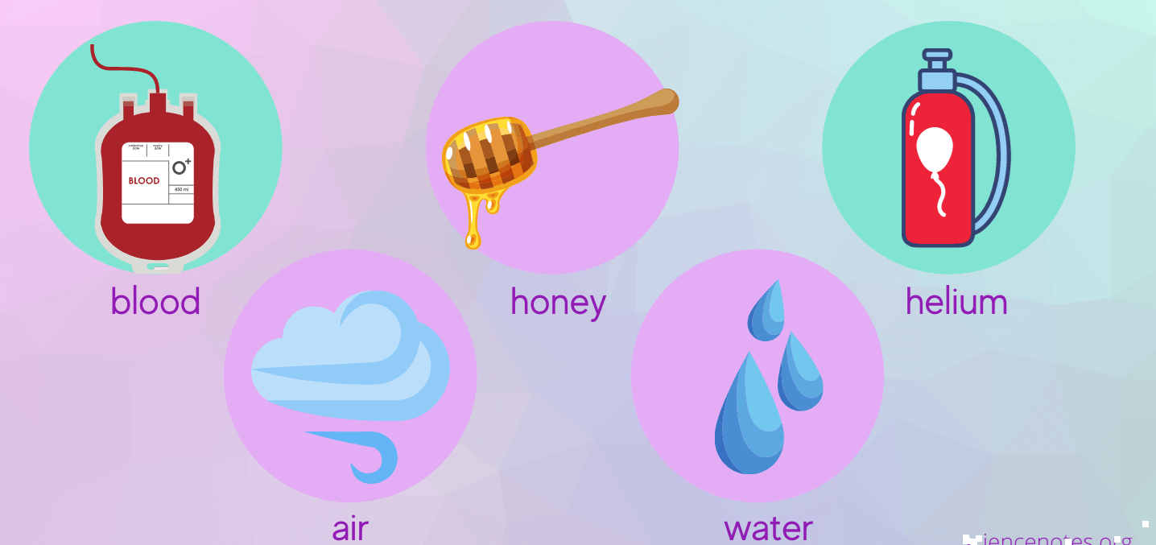
Fluid
The substances which can flow easily are called fluids.
The particles of liquids and gases are not bound so tightly, hence they can flow.
It has no definite shape of its own.
All liquids and gases are fluids .
Example - water, oil, air etc.

Slide 4
Ideal Fluid
Real Fluid
Newtonian Fluid
Non-Newtonian Fluid
Ideal Plastic Fluid
Compressible Fluid
Incompressible Fluid
Types of Fluid

Slide 5
Properties of Fluid
Every fluid has certain characteristics which describe the physical condition of the fluid. Such characteristics are called properties of fluids.
Density
Specific Weight
Specific Volume
Specific Gravity
Surface Tension
Vapour Pressure
Capillarity
Viscosity

Slide 6
Density
It is the mass of fluid per unit volume. It is also known as mass density (or) specific mass and is denoted by Greek letter ρ (rho).
Density (ρ) = Mass (M) / Volume (U) unit in kg/m³
The density of water and air at the standard temperature of 4°C are 1000 Kg/m3 and 500 Kg/m³ respectively.

Slide 7
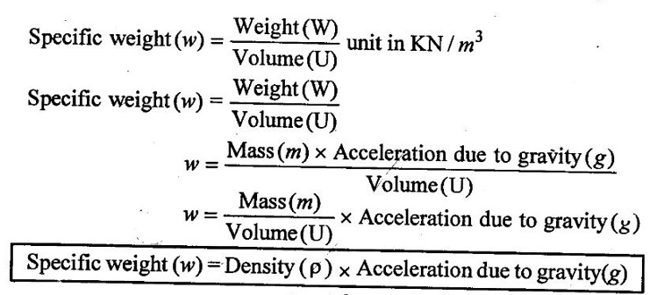
Specific Weight
It is the weight of fluid per unit volume. It is also known as weight density and is denoted by ω.
The specific weight of the water at the standard temperature of 4°c is 1gm/cm³
1000 kg/m³
9810 N/m³
9.81KN/m³

Slide 8
Specific Volume
Specific volume is the volume of fluid per unit mass. It is the reciprocal of density.
It is denoted by U_{s}.

Slide 9
Specific Gravity
It is the ratio of density of any given fluid to density of the standard fluid at standard temperature of 4°C. It is also defined as the ratio of specific weight of any given fluid to specific weight of the standard fluid at standard temperature of 4°C. It is also called as relative density and denoted by S.
Specific gravity is a mere number and has no units
The standard fluid is water for comparing liquid and air is the standard fluid for comparing gases.
Specific gravity of water = 1
Specific gravity of mercury = 13.6
Specific gravity of air = 1

Slide 10
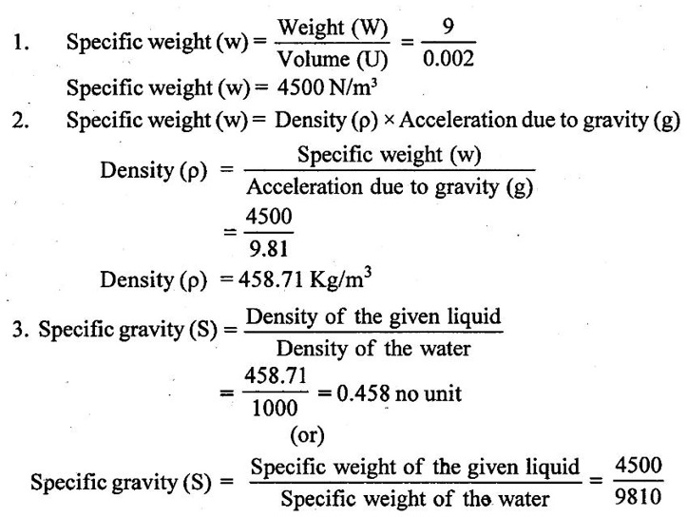
Problem Solving
Example - 1
Calculate the specific weight, density and specific gravity of two litre of a liquid which weighs 9N.
Given data:
Volume (U) = 2 Litre = 2/1000 m³ (or) 2 × 10⁻³ (or) 0.002 m³
Weighs (W) = 9N
To find:
Specific weight(w), Density (p), Specific gravity(S)
Solution:
Specific gravity (S) = 0.458 No unit

Slide 11
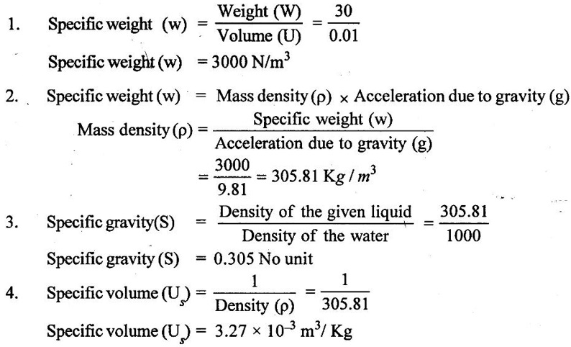
Problem Solving
Example - 2
Calculate the specific weight, mass density, specific gravity and specific volume of oil having a volume of 10000cm³ and weight of 30N.
Given data:
Volume (U) = 10000cm³ = 10000 / 1000000 m³ (or) 0.01 m³
Weight (W) = 30N
To find
(i) Specific weight (w)
(ii) Mass density (ρ)
(iii) Specific gravity (S)
(iv) Specific volume (V_{s})
Solution :

Slide 12
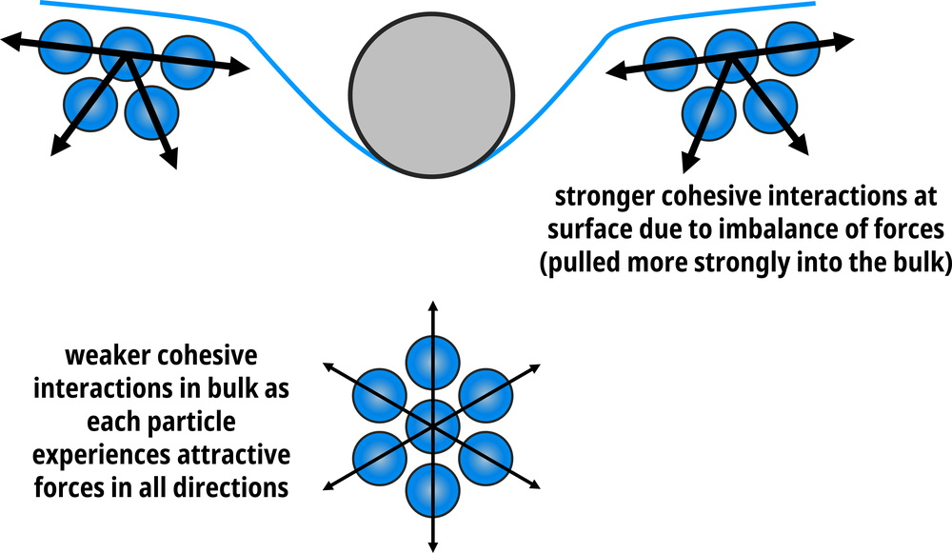
Surface Tension

Slide 13
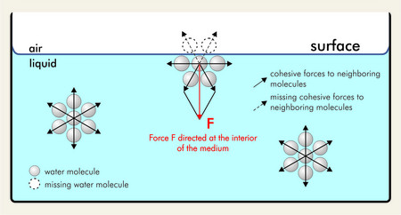
Surface Tension
It is the tendency of liquid surfaces to shrink in minimum surface area. Surface tension is caused by cohesive forces between the liquid molecules.
Note: Surface tension is the main reason for most insects to float on the water despite being denser than water.

Slide 14
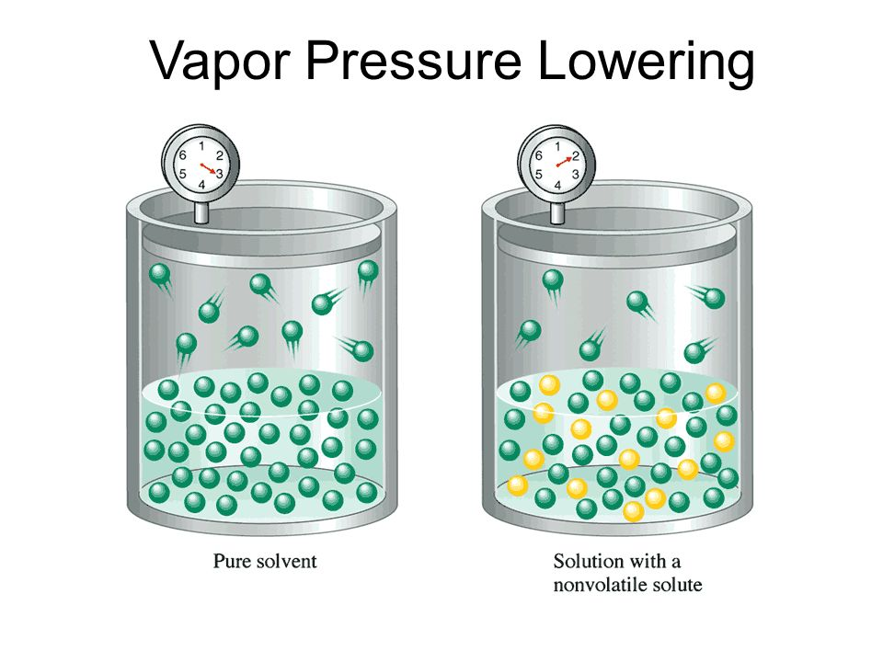
Vapor Pressure
The vapour pressure of a liquid is the equilibrium pressure of a vapour above its liquid.
The vapour pressure of a liquid varies with temperature. As the temperature increases, the vapour pressure also increases.
It does’nt varies with quantity of liquid and surface area of liquid.

Slide 15
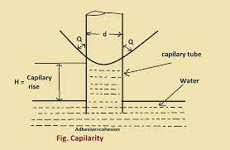
Capillarity
Capillary action as a phenomenon where the ascension of liquids through a tube or cylinder takes place.
This primarily occurs due to adhesive and cohesive forces.
The liquid is drawn upward due to this interaction between the phenomena. The narrower the tube, the higher will the liquid rise.
Capillarity is an invisible force that works against the force of gravity. It pushes a liquid up in a tube or a narrow pipe. This rising of liquid is the capillary action. We call such liquid capillary water because the water follows the principle of capillarity.

Slide 16
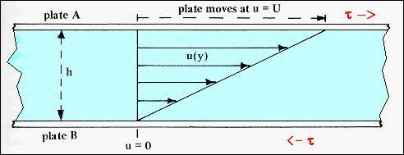
Viscosity
Viscosity is a measure of a fluid's resistance to flow.
Viscosity is a property of a fluid that determines its flow behavior.
The higher the viscosity the less easily the fluid can flow. Air has a low viscosity compared to water, and water a low viscosity compared to an automotive gear oil.
The SI unit of viscosity is poiseiulle (PI). Its other units are newton-second per square metre (N s m⁻²) or pascal-second (Pa s.) The dimensional formula of viscosity is [ML⁻¹T⁻¹].

