Slide 1
27241 Circuits and Electrical Machine in RAC
Tanvir mohammad faisal
Instructor/Rac
Dhaka polytechnic institute

Slide 2
Chapter-1 Introduction to electric circuits

Slide 7
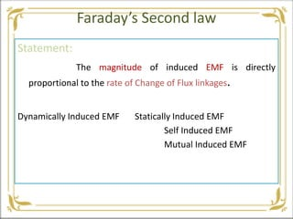

Slide 10
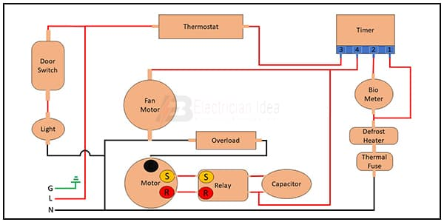
Chapter-2 Non frost type electric circuit

Slide 11
Chapter-3

Slide 12
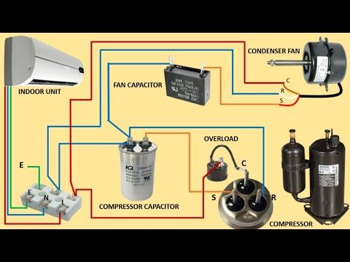
Chapter-5

